Slide 1
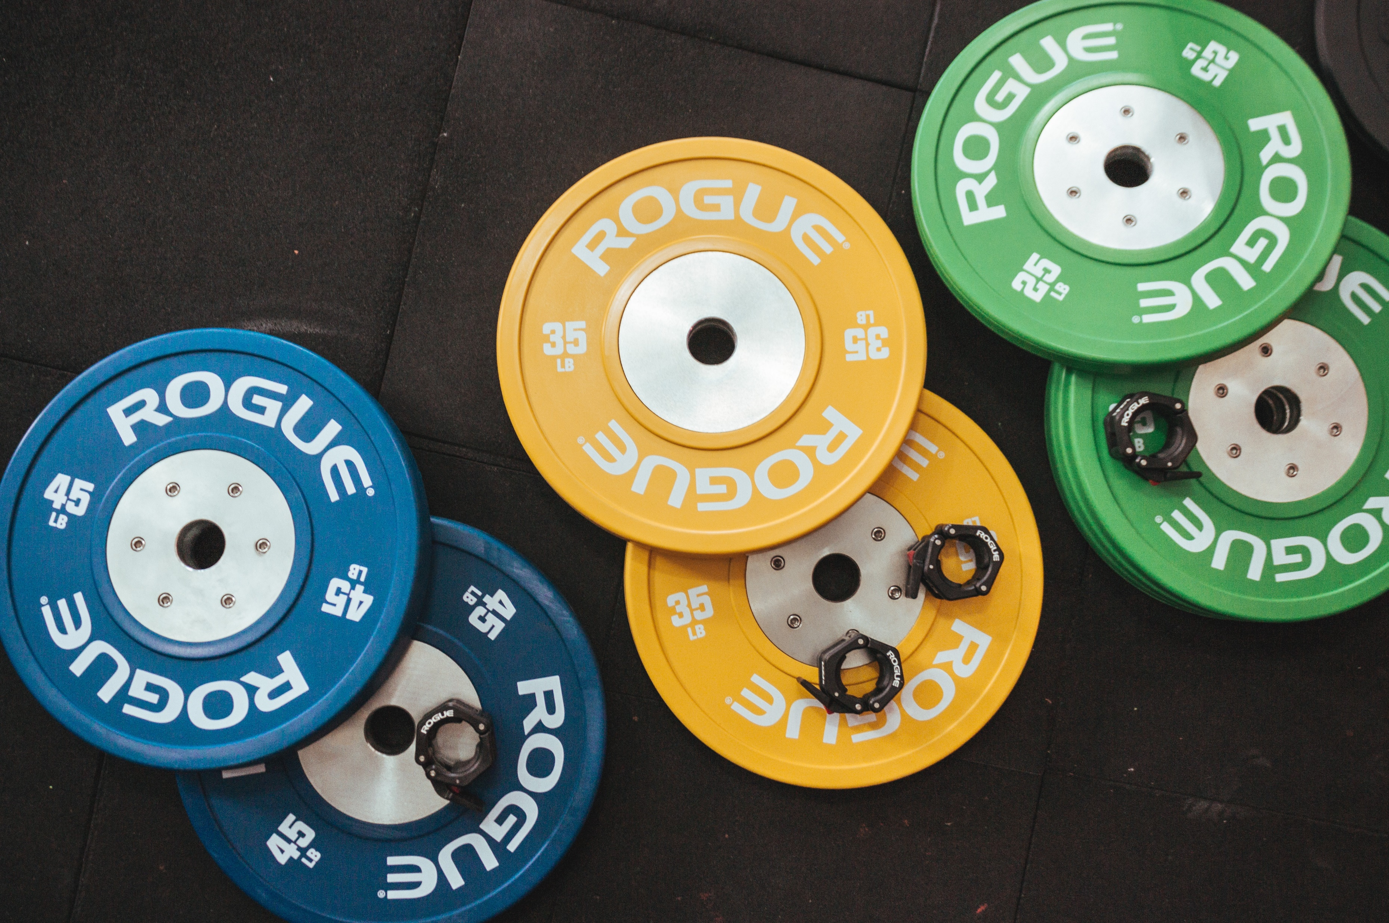

CASE STUDY Fitness app that offers personalized workout plans and trainer consultation

Slide 2
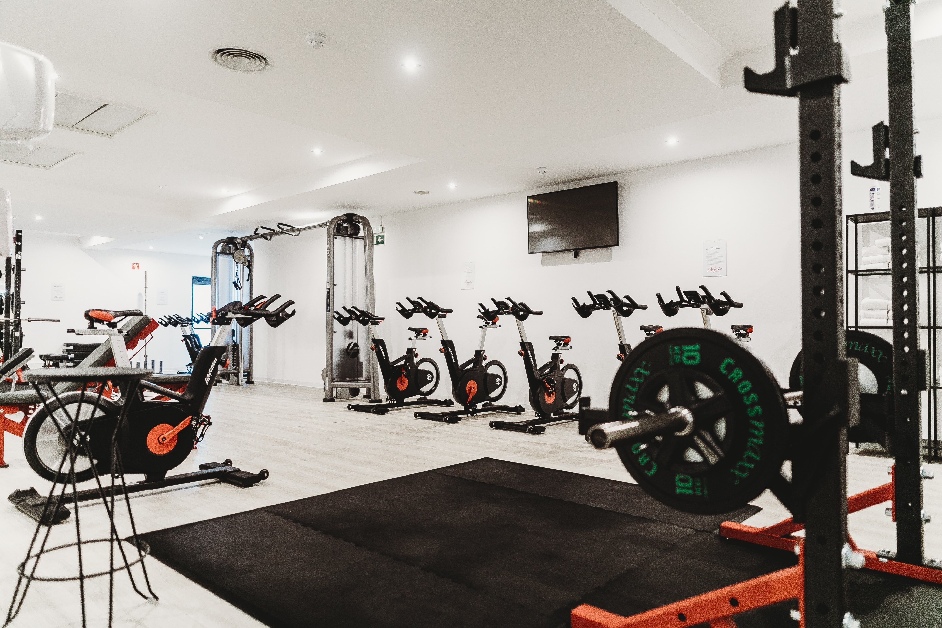

A practical case study presenting UI and UX design for a mobile gym fitness app a convenient user interface with custom icons and original onboarding illustrations. The mobile app industry is one of the biggest in the digital market. There is no surprise, since many businesses both small and big aim at creating their own mobile app. A powerful application can help to set connection with potential customers as well as bring new solutions to enhance services.
UI and UX design is vital for app performance. Every year people’s expectations about mobile applications grow. They want a mobile app to be fast and easy to use due to the delightful interaction and navigation systems. Moreover, UI design should be appealing and original so that an app could catch users’ interest, make them stay and discover the functionality. Today, I have share a case study showing the creative process of UI and UX design for a fitness app.

Slide 3
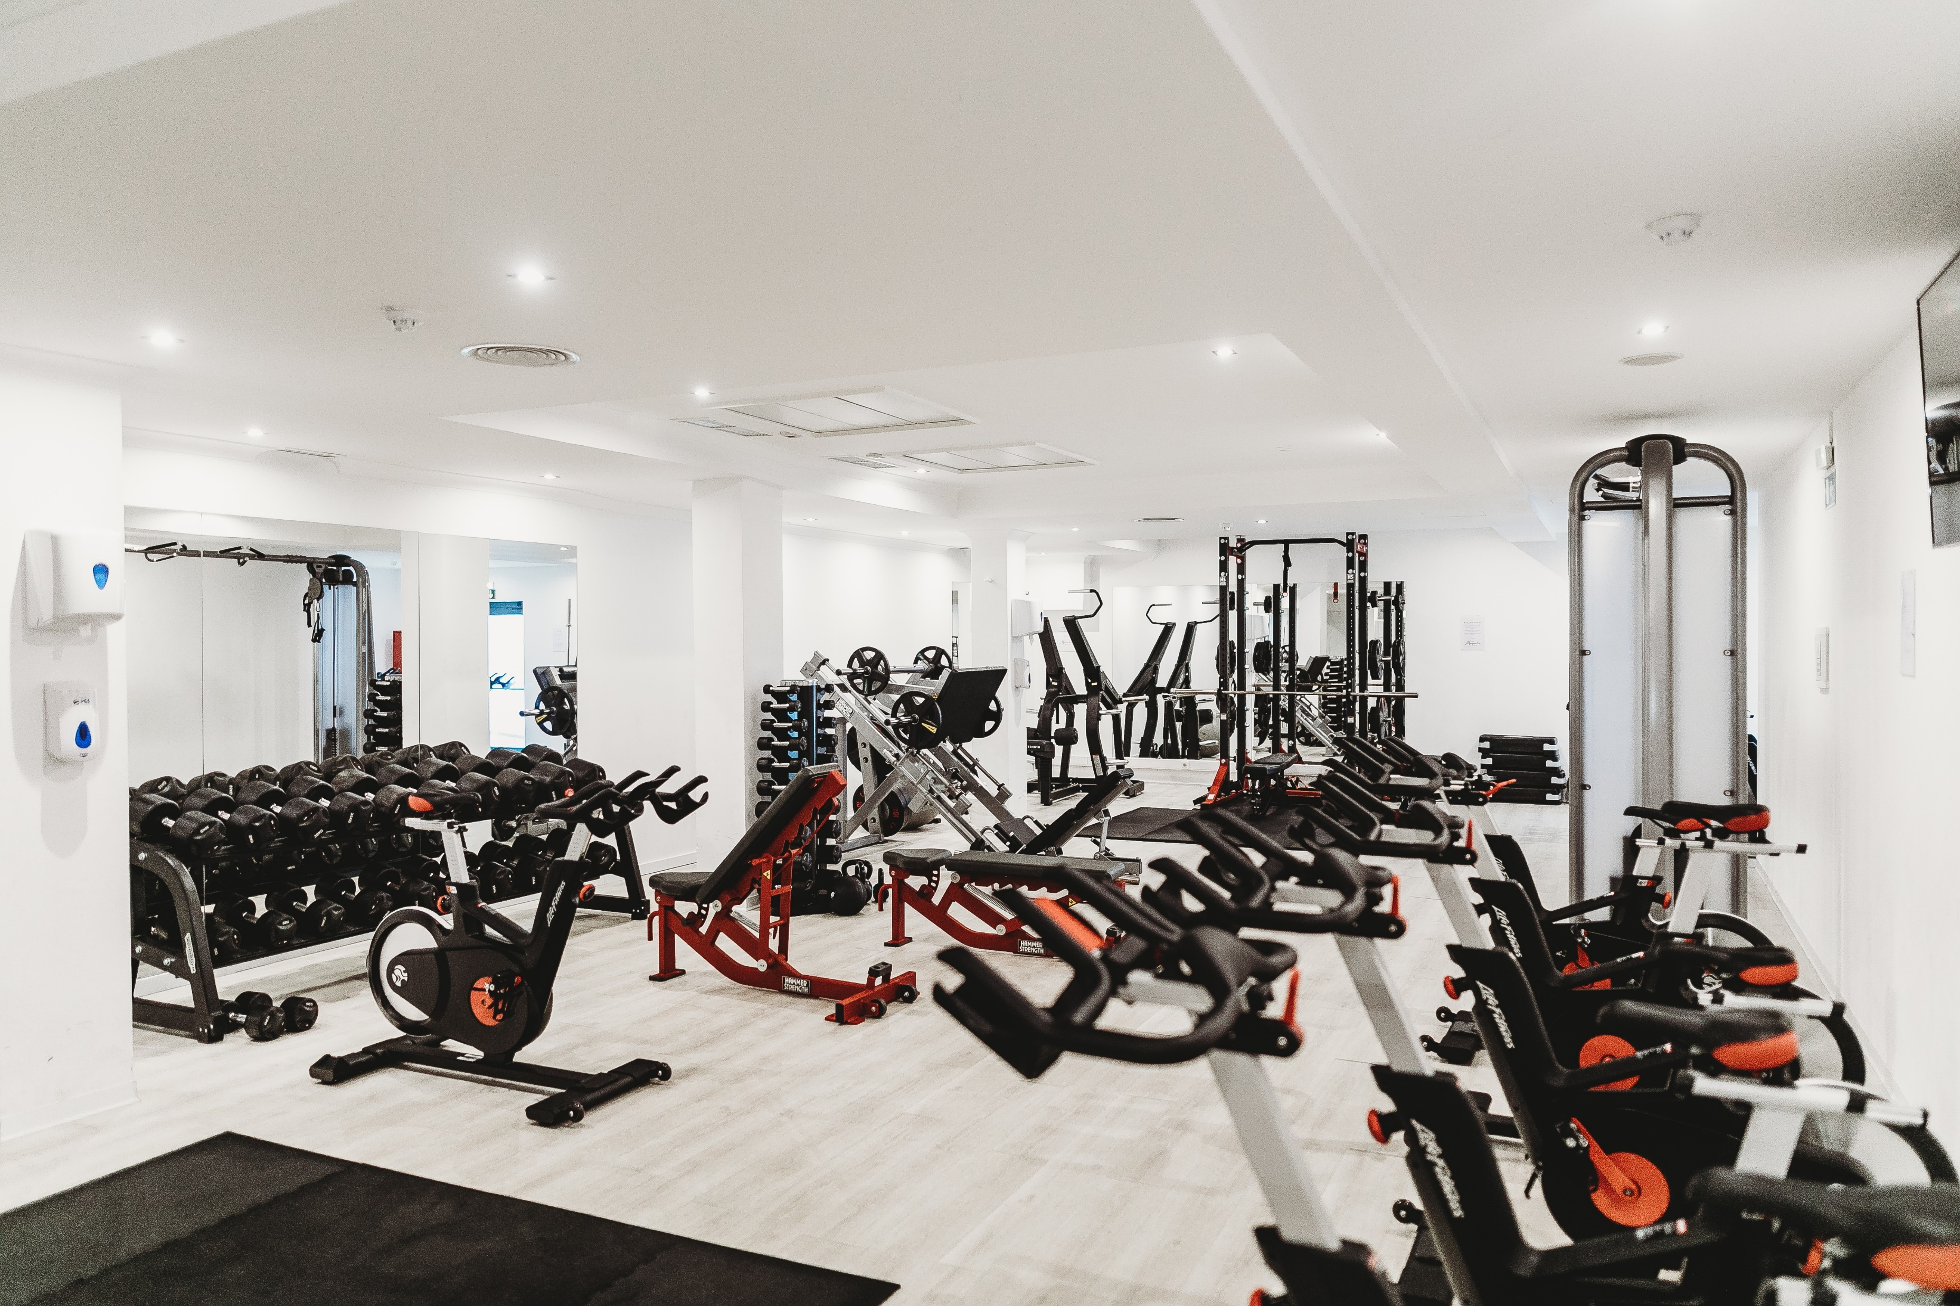
Task
UI and UX design for a mobile gym fitness app.
Process
The client was the ABC from India. They made a request to design a new product called App Name a mobile application for fitness professionals and gym members. The app was aimed at helping people to find personal trainers in various gyms and book a session without being a member of a particular gym. Users would be able to browse for nearest available trainers, gyms, or group classes via a map or a list sorted by distance and closest start time. Moreover, the app could be useful for fitness instructors as a tool for managing clients. The specific feature of this app was expected to have an in-app payment for a session.
This ABC company wanted the design for their app to be dynamic and youthful supported with original user onboarding tutorials. In addition, they asked to pay attention to the navigation so that users could find trainer connections fast and without efforts.

Slide 4
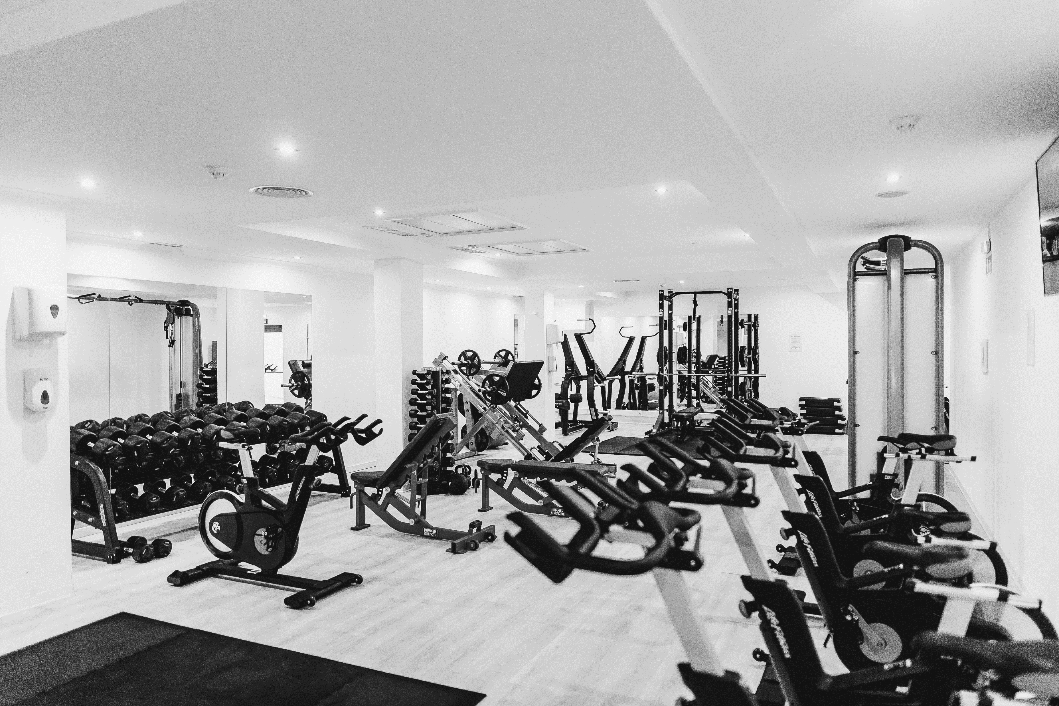
UX Design
When all the requests were considered, the designer went to the stage of wireframing. A wireframe is a simplified and schematic visual representation of a layout for app screens and transitions. It is a fast way to plan the information architecture and ensure that developers and clients get a clear understanding of the project structure. Furthermore, in case the client wants to make some changes, a wireframe is much easier to reshape.
Here are the wireframes created for App Name. The designer planned the basic layout including login and home screens. Under login button providing a choice for users. In addition to make profile more personalized the login process also contained a screen where people could choose their goals

Slide 5
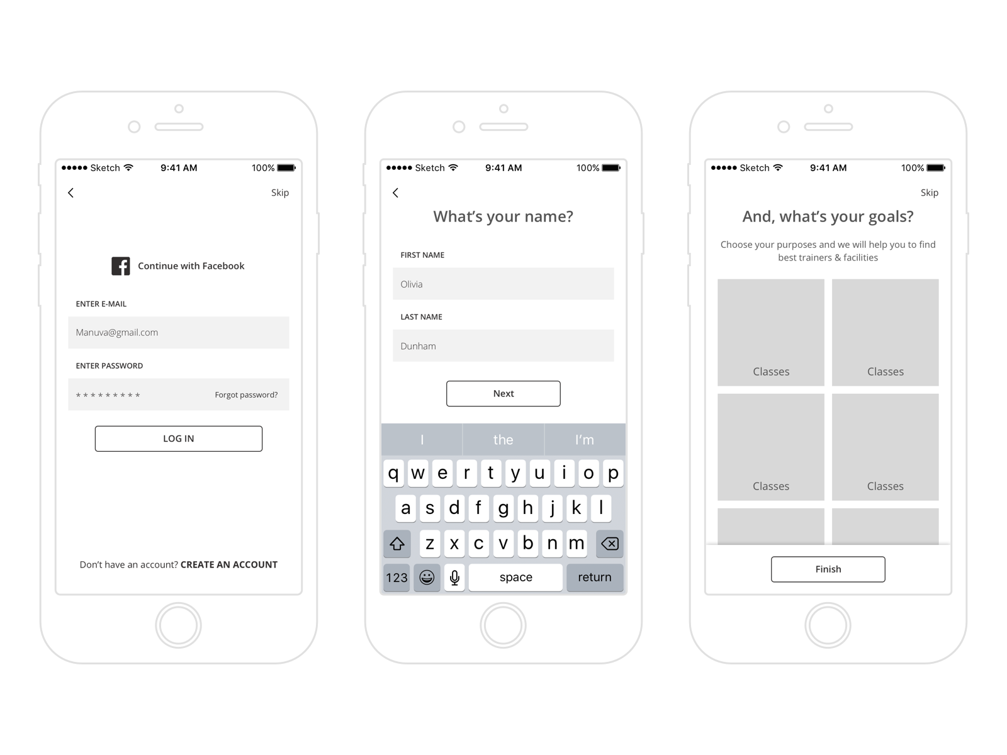

Slide 6
Information Architecture
IA forms a skeleton of any design project. Visual elements, functionality, interaction, and navigation are built according to the information architecture principles. Based on the user needs and problems I reached earlier, I started to form the skeleton of my project to assist me. This way I’m sure I avoid designing bad navigation and prevent users from being lost and feeling annoyed.

Slide 7
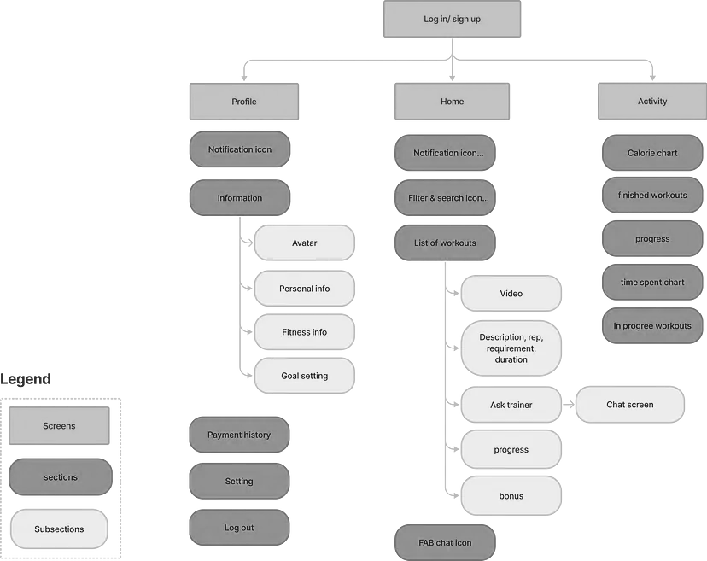

Slide 8

User Workflow
I drew a user flow to visualize how the user would navigate through the product to achieve their goals and ensure that the product prioritizes users’ needs.

Slide 9
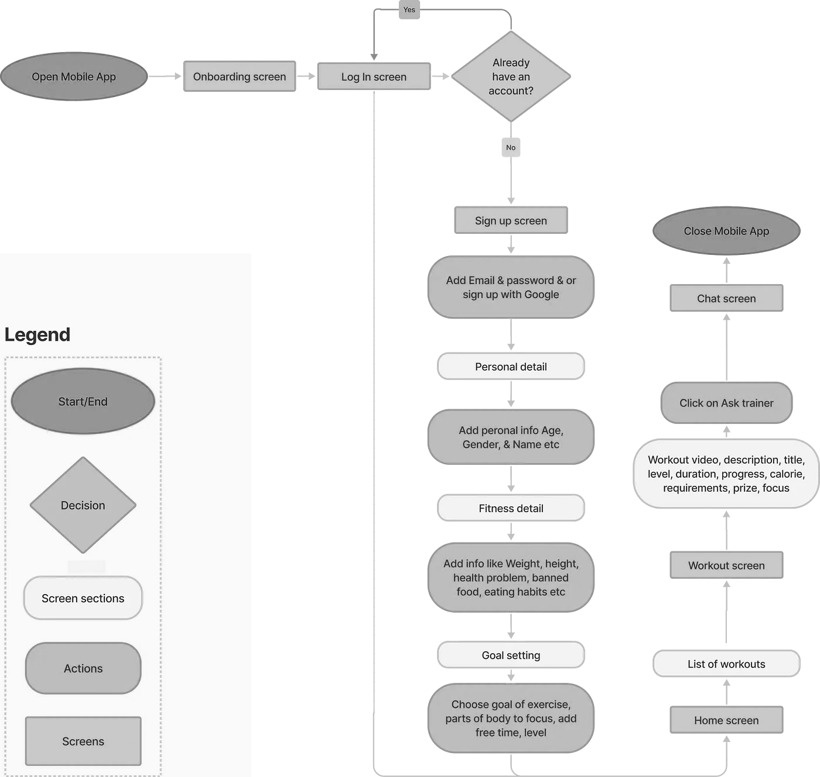

Slide 10

UI Design
When the structure was approved, the designer started working on the presentation of the UI elements. One of the tasks was to find an effective color palette for the interface. The thing is that color has a significant influence on our visual perception and the first impression of a product. Inappropriate colors may affect some of the usability aspects such as readability of copy elements and user satisfaction. Moreover, it’s important to consider the preferences of the target audience: people perceive colors differently depending on their age, gender, and culture.

Slide 11
Final Thoughts
I enhanced a fitness app that allows the users to have access to personalized, categorized workout plans, chat with trainers in case of problems and can monitor their progress in the form of time spent and calorie burn. I believe I have met the goals that were outlined at the beginning of the design process.

